Slide 1
Migration of Microsoft365 to Own Tenant
21 May 2024
Data & Analytics Department

Slide 2
AGENDA
1
2
3
4
5
6
7
8
9
Background and Objective
Current Limitation
Other market’s Offboarding Experience
Proposal
Project Charter
Project Team
Project Timeline
Next Steps
Questions & Answers (Q&A)

Slide 3
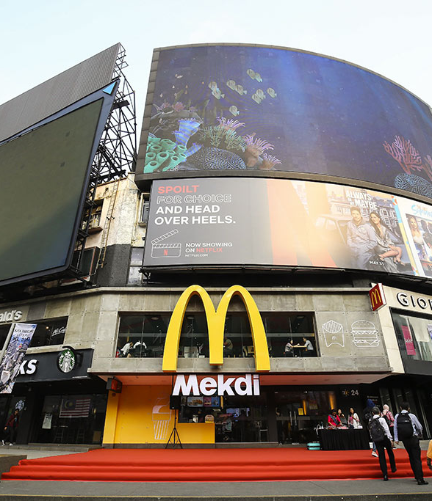
Background and Objective

Slide 4
Background and Objective
BACKGROUND
OBJECTIVE
McD Malaysia is paying around RM1.1 million to Microsoft via Global IT billing as part of Global Technology Enterprise Services (GTES) with the minimum usage of the Microsoft product.
Limitation of the system's capability due to restriction from the Global (direct licensee) regarding security and accessibility.
(We pay Ferrari but functionality like Kancil)
The Digital & IT division proposed to migrate Microsoft365 to its own tenant thus McD Malaysia will have full ownership.
Increase business efficiency as it can leverage full suite of Microsoft365
Fully utilise the Microsoft product (Power BI, Power Apps, Power Automate, etc.)
Access to One Drive/Form
Access to SharePoint capabilities
Ability to adapt quickly to dynamic needs of business
Self-managed and have ownership of the system for accessibility and Cybersecurity (advance security protection and data leak prevention)
Functionalities of Microsoft Teams and SharePoint
Disaster Recovery (follow up w Wil Son)
Cost benefit to the company as it will be managed internally

Slide 5
Current Limitation

Slide 6


Current Limitation But Not Limited To
Use my.mcd.com | Microsoft’s custom tenant http://garsbmy.onmicrosoft.com/
Do not have access to Power BI Pro License Do not have M365 based teams SharePoint access Do not have access to other new M365 capabilities such as M365 CoPilot, etc | Limited Power BI Pro Licenses Users have to switch accounts and might forget or wrongly key in the password.

Slide 7
Other market’s Offboarding Experience

Slide 8



Other Market
Category | Indonesia | Hong Kong
Background | Fully owned managed tenancy Link back to Global via GAMS in 2017 Number of restaurants: 360 restaurants Number of users for Operations: 360 Number of users for HQ: 300 Number of personnel supporting tenant management (Operations and Admin): 2 | Journey started in 2017 Took 4 months to fully migrated Number of restaurants: 255 restaurants Number of users for Operations: 500+ Number of users for HQ: 500 Number of personnel supporting tenant management: 1 Manager and 2 Helpdesk engineers
Partner | Worked together with Microsoft partner in Indonesia for license. For the first 3 months they engaged vendor to manage their tenancy, and once GAM was implemented take over all the management and security roles. | Worked together with local Microsoft (HK) for consultancy on the migration. Work with SPAN for the migration.
Experience |  | Advice given: To appoint the Project Manager for the migration and work with global McD to avoid misconfiguration or miscommunication. Ensure the escalation point from GTES/GTIO for migration-related support.

Slide 9
Other Market
Category | Indonesia | Hong Kong
Security | Do not use Proofpoint for email protection but use Microsoft 365’s built-in protection. | Do not use Proofpoint for email protection. Outsourced CyberSecurity to local vendors due to governmental local regulation for Tier 2 support. Local vendor handles the Security Operations Center (SOC) Vendor SOC Scope: Proactive monitoring of CyberSecurity Incidents Use DarkTrace solution to monitor network traffic (Subscribed as a separate license) Local TSC Scope: Patching and OS hardening by the internal Tier 1 team. Subscribed to MS Defender Advanced Threat Protection (Defender ATP) which is subscribed separately from Microsoft365.

Slide 10
Other Market
Category | Indonesia | Hong Kong
Notes | Mostly use O365 E3 licenses (to use Excel desktop instead of excel online due to poor internet connectivity to their stores nationwide) | Work with SPAN to ensure all mailboxes were migrated successfully and all cleanups were successful (ensure no link to GPO, etc.). Some AD-related cleanup was done during the migration. Shared mailboxes were re-created post-migration. Offboarded to Sharepoint online after a few quarters. Independently managed tenancy helped enable CoPilot effort which otherwise they could not have gained access with the prior globally managed tenancy. Use GAM for the user administration. Converted all the reporting that was needed to Tableau and Cognos.
Cost |  | For SPAN: CAPEX: one-off / 8000 USD OPEX: 4000 USD / month for 800 users Approximately overall cost: Assuming 1% Technology Budget is allocated from Revenue 30% of their Technology Budget is allocated to CyberSecurity

Slide 11
Proposal

Slide 12
Proposal
WIP
No | Proposal | Benefit | Cost (RM) | Cost (USD)
1. | New tenant setup and migration cost One-time cost to migrate from current corporate tenant to own tenant | Cost Avoidance | 473,000 | 100,638
2. | Migrate and upgrade from Microsoft365 E3 license to Microsoft365 E5 license Cost of software license | Cost Benefit Increase efficiency | TBC
3. | Infrastructure and Security Management level approach One-time cost – This will be under IT Cybersecurity initiative Yearly recurring cost for infrastructure support | Cost Benefit Operational efficiency | TBC

Slide 13
New tenant setup and migration cost
No | High Level SoW | Costing (RM)
Professional Fees
1 | SPAN (Global IT Vendor) Offboarding Malaysia from global vNext tenant into their own separate tenant and stay connect on Global Active Directory. | 275,000
2 | GTRM (Global IT Team) Azure AD Setup, MIM Configuration, Removal from MCD tenant, Synchronization to new Market Tenant | 55,000
3 | GTES (Global IT Team) SharePoint one time costing from GTES ECC Team. around Changing all access to Global SharePoint to External Access so that users can continue access to global SharePoint site. | 33,000
4 | <To be confirmed> (Local IT Solution Provider) Work with SPAN on configuration, license subscription and end user deployment, including data migration | 110,000
TOTAL ONE TIME COST (RM) |  | 473,000

Slide 14
Migrate and upgrade to Microsoft365 E5 license and Infrastructure & Security Management cost
WIP
No | Descriptions |  | No of Users |  | Current - Global Tenancy |  | No of Users |  | To-Be - Own Tenancy |  | Comparison
 |  |  |  | (USD) /user/month | (USD) /user/year | Expenses /Year (RM) |  | (USD) /user/month | (USD/user/year) | Expenses /Year (RM) | Difference (RM) | Difference (%)
Software Licenses – RM 1,037,760
1 | M365 E5 (RSC) |  | 400 | 36 | 432 | 812,160 | 400 | 57 | 684 | 1,285,920 | +473,760 | +58%
 | Information Workers |  |  | (SKU 5030) | (SKU 5030) |  |  | (SKU 5030)
2 | O365 E1 (Store) |  | 400 | 4.7 | 56.4 | 106032 | 400 | 10 | 120 | 225,600 | +119,568 | +113%
 | Deskless Worker |  |  | (SKU 5031) | (SKU 5031) |  |  | (SKU 5031)
3 | Mobile Device Mgt (RSC) |  | 400 |  | 60 | 112,800 | 400 |  | Included | Included | -112,800 | -100%
Software Licenses under Garsb – RM 479,400
4 | Power BI Premium |  | 25 | 21 | 257 | 30,215 | 25 | 20 | 240 | 28,200 | -2,015 | -7%
5 | Power BI Pro | RSC | 400 | 10.25 | 123 | 462,480 | 0 | 10 | 120 | 225,600 | -236,880 | -51%
 |  | Store | 400 |  |  |  | 400
Infrastructure Services – RM 467,438
6 | AD Connect |  | 4 servers |  | Included | Included | 4 servers |  | 30,000 | 30,000 | +30,000 | +100%
 |  |  |  |  |  |  |  |  | (server/year) | (SKU7078)
7 | SPAN Support Management (Est.12% of license cost) |  | All users |  | Included | Included | All users |  | N/A | 211,838 | +211,838 | +100%
TOTAL ON GOING COST |  |  |  |  |  | 1,523,687 |  |  |  | 2,007,158 | +483,472 | +32%
Note: Migrate all RSC users from M365 E3 to M365 E5 but retain O365 E1 (Store) license and outsource Security Operations to External Vendor

Slide 15
No | Descriptions |  | No of Users |  | Current - Global Tenancy |  | No of Users |  | To-Be - Own Tenancy |  | Comparison
 |  |  |  | (USD) /user/month | (USD) /user/year | Expenses /Year (RM) |  | (USD) /user/month | (USD/user/year) | Expenses /Year (RM) | Difference (RM) | Difference (%)
Software Licenses – RM 1,765,320
1 | M365 E5 (RSC) |  | 400 | 36 | 432 | 812,160 | 400 | 57 | 684 | 1,285,920 | +473,760 | +58%
 | Information Workers |  |  | (SKU 5030) | (SKU 5030) |  |  | (SKU 5030)
2 | O365 E1 (Store) |  | 400 | 4.7 | 56.4 | 106032 | 400 | 10 | 120 | 225,600 | +119,568 | +113%
 | Deskless Worker |  |  | (SKU 5031) | (SKU 5031) |  |  | (SKU 5031)
3 | Mobile Device Mgt (RSC) |  | 400 |  | 60 | 112,800 | 400 |  | Included | Included | -112,800 | -100%
4 | Power BI Premium |  | 25 | 21 | 257 | 30,215 | 25 | 20 | 240 | 28,200 | -2,015 | -7%
5 | Power BI Pro | RSC | 400 | 10.25 | 123 | 462,480 | 0 | 10 | 120 | 225,600 | -236,880 | -51%
 |  | Store | 400 |  |  |  | 400
Infrastructure Services – RM 467,438
6 | AD Connect |  | 4 servers |  | Included | Included | 4 servers |  | 30,000 | 30,000 | +30,000 | +100%
 |  |  |  |  |  |  |  |  | (server/year) | (SKU7078)
7 | SPAN Support Management (Est.12% of license cost) |  | All users |  | Included | Included | All users |  | N/A | 211,838 | +211,838 | +100%
9 | Security Service (ProofPoint) |  | 800 |  | Included | Included | 800 |  | 60 | 225,600 | +225,600 | +100%
SecOps Services – RM 150,000
 | External (Vendor) |  |  |  | Included | Included |  |  |  | 150,000 | +150,000 | +100%
TOTAL ON GOING COST |  |  |  |  |  | 1,523,687 |  |  |  | 2,382,758 | +859,072 | +56%

Slide 16
Project Charter

Slide 17
Project Charter
WIP
Opportunity Statement |  |  | Goals (What does success look like?) | Scope
McD Malaysia is paying around RM2.5 million to Microsoft via Global IT billing as part of Global Technology Enterprise Services (GTES) with the minimum usage of the Microsoft product. Limitation of the system's capability due to restriction from the Global (direct licensee) regarding security and accessibility. (We pay Ferrari but functionality like Kancil) The Company faced a few challenges in preparing the report or analyze the data as follows: Do not have proper collaboration platform. Possibility of making mistakes for analysis due to the data is not standardized. Do not fully utilise the Microsoft functionality. |  |  | Primary goal: Own tenant and full ownership Target: Increase business efficiency as it can fully utilize the Microsoft product Secondary Goal: Self-managed and gives cost benefit to the company Target: Cost avoidance as it will be managed internally | In-Scope: Software license under Microsoft Out of Scope: N/A
Key Deliverables |  |  | Dependency
Availability of the Microsoft platforms in our platform The company will use Microsoft365 E5 license |  |  | Implementation of Firewall project (CyberSecurity Initiatives)
Key Activities
Description | Stakeholders | Target Date
Formalize project team
Progress review meeting
Final “tollgate” prior testing
Go-Live |  | 1 Oct 2024

Slide 18
Project Team

Slide 19
Project Team: Roles & Responsibilities
Project Sponsor
Zaid
Project Sponsor: Senior Leadership Sponsor and support the team’s project To provide guidance relating to strategic vision, project requirements, expectations, and resolution.
Project Champion
Radzman (TS) & Hazlan (DnA) & Kian Hee
Project Champion: To provide team members with inspirational, motivational support, and resources needed, as well as serve as an advocate for the project to ensure stakeholders are satisfied
Project Leader: To coordinate with all team members on the project requirement and deliverables. To provide guidance to the team members on matters relating to project assignments To provide the team members appropriate vision and goals of the project objectives. To ensure all team members address relevant issues within a specified time frame to meet respective objectives To provide necessary data related to project benefits To validate and endorse the data on financial benefits
Project Lead
Wil Son, Azimah (A)
Efficiency & Category
Team Member – DnA
Jag
DnA Team Member: To provide guidance on project management framework and deliverables To monitor and review process performance before and after solution go-live including stabilization To recommend the best technology enabler based on consolidated requirements To develop and implement in-house solutions to support the operational team
Team Member – Digital &IT
Fairuz, Afiq Azmi
Team Member (Dept/Section Name): To assist in getting data for analysis purposes. Involve in brainstorming sessions i.e. Fishbone Analysis, Root Causes Analysis, Etc. To execute the improvement initiative as planned

Slide 20
Project Timeline

Slide 21

Proposed Project Timeline
WIP
Legend:
Communication
Event
2024
APR | MAY | JUN | JUL | AUG | SEP | OCT
GO-LIVE
Discovery & Assessment
Management Approval on the Business Case
Planning & Design
Preparation & Testing
Announcement for system cut-off
Migrate
Go-Live
Announcement
Post-Migrate
Note: Pre-Requisite requirement before Migration is Firewall project to Go-Live

Slide 22
Next Steps

Slide 23
Next Steps
Recalibrate the costs of those proposals including those related to Global.
To prepare the proposal deck for management approval.
Present and get approval from the Management Team.

Slide 24
Questions & Answers (Q&A)

Slide 25
Thank you

Slide 26

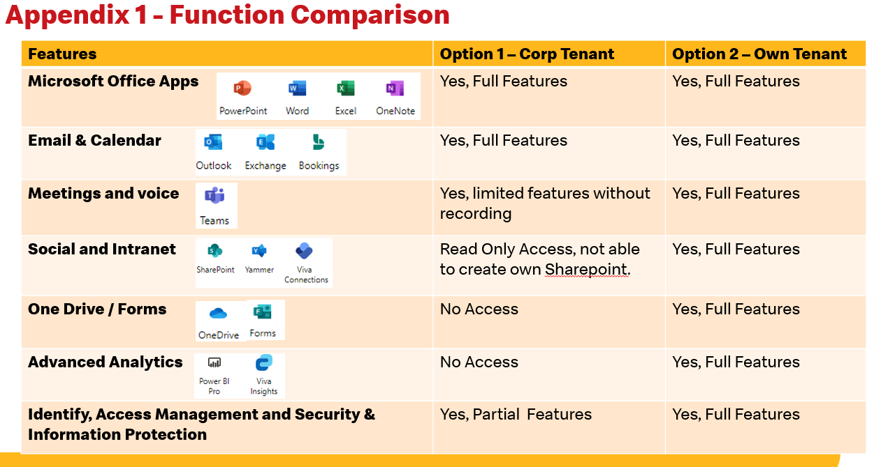
Functionality Comparison
No | Features | Product | Corporate Tenant | Own Tenant
1. | Microsoft Office Apps | Power BI Power Apps Power Automate | Limited features | Full Features
2. | Email & Calendar | Outlook Exchange Bookings | Full features | Full features
3. | Meetings & Voice | Teams | Limited features without recording | Full features
4. | Social & Intranet | SharePoint | Access: Read Only Unable to create own SharePoint | Full Features
5. | One Drive/Forms | OneDrive Forms | Do not have access | Full Features
6. | Advanced Analysis | Power BI Pro Viva Insights | Do not have access | Full Features
7. | Identify, Access Management and Security & Information Protection | Microsoft Access Management | Limited Features | Full Features

Slide 27
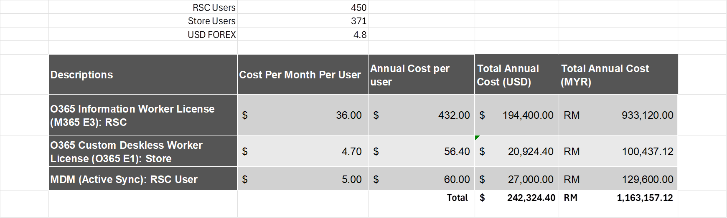
Appendix 2
Descriptions | No of Users | Cost Per Month Per User (USD) | Annual Cost per user (USD) | Total Annual Cost (USD) | Total Annual Cost (MYR)
RSC Users | 450
Store Users | 371
O365 Information Worker License (M365 E3): RSC |  | 36.00 | 432.00 | 194,400.00 | 933,120.00
O365 Custom Deskless Worker License (O365 E1): Store |  | 4.70 | 56.40 | 20,924.40 | 100,437.12
MDM (Active Sync): RSC User |  | 5.00 | 60.00 | 27,000.00 | 129,600.00
Total |  |  |  | 242,324.40 | 1,163,157.12

Slide 28
Appendix 3 – Quotation from Alfacom
Subscription | Annual Subscription / Per User (RM)
Office 365 E3 | 1,302.30
Office 365 E5 | 2,151.63
Power BI Pro | 566.22
Enterprise Mobility + Security E3 | 600.19
Enterprise Mobility + Security E5 | 928.60
Windows 11 Enterprise E3 | 396.35
Windows 11 Enterprise E5 | 622.84
Microsoft 365 E3 | 2,032.35
Microsoft 365 E5 | 3,217.88

Slide 29







Appendix 1 - Function Comparison
Features | Option 1 – Corp Tenant | Option 2 – Own Tenant
Microsoft Office Apps | Yes, Full Features | Yes, Full Features
Email & Calendar | Yes, Full Features | Yes, Full Features
Meetings and voice | Yes, limited features without recording | Yes, Full Features
Social and Intranet | Read Only Access, not able to create own Sharepoint. | Yes, Full Features
One Drive / Forms | No Access | Yes, Full Features
Advanced Analytics | No Access | Yes, Full Features
Identify, Access Management and Security & Information Protection | Yes, Partial Features | Yes, Full Features

